Slide 2
Qualitative Aptitude:
Abstract Visual Tests
Abstract Verbal Tests
Word Usage
Vocabulary

Slide 3
Qualitative Reasoning (QR) is an area of research within Artificial Intelligence (AI) that automates reasoning about continuous aspects of the physical world, such as space, time, and quantity, for the purpose of problem solving and planning using qualitative rather than quantitative information.^{[1]} Precise numerical values or quantities are avoided, and qualitative values are used instead (e.g., high, low, zero, rising, falling, etc.).^{[2]}

Slide 4
Cognitive ability
Content-based recommender systems
Collaborative Filtering

Slide 5
cognition
the mental action or process of acquiring knowledge and understanding through thought, experience, and the senses
Cognitive

Slide 6
An abstract reasoning test measures your ability or aptitude to reason logically. Generally, abstract reasoning tests measure non-verbal abilities. You must, through logical and abstract reasoning, extract rules, analogies and structures which you subsequently use to find a correct answer among a set of possible options.

Slide 7
Abstraction in its main sense is a conceptual process where general rules and concepts are derived from the usage and classification of specific examples, literal ("real" or "concrete") signifiers, first principles, or other methods.
"An abstraction" is the outcome of this process—a concept that acts as a common noun for all subordinate concepts, and connects any related concepts as a group, field, or category.^{[1]}

Slide 8
Abstraction also arises in the relation between syntax, semantics, and pragmatics.

Slide 10
Abstract Visual Tests

Slide 11
An abstract reasoning test measures your ability or aptitude to reason logically. Generally, abstract reasoning tests measure non-verbal abilities. You must, through logical and abstract reasoning, extract rules, analogies and structures which you subsequently use to find a correct answer among a set of possible options.

Slide 12
‘What’s being measured in an abstract reasoning test?’
Your abstract reasoning test will assess your ability to identify and interpret patterns. How easily can you see rules & consistent patterns in sets of objects and verbal data? Can you tell how a pattern of objects in a sequence should continue?

Slide 13
‘Is this the same thing as inductive reasoning and diagrammatic reasoning?’
Overlap

Slide 14
‘When will I take my abstract reasoning test?’
It depends on your prospective employer. Sometimes candidates are asked to take an abstract reasoning test before an interview or assessment event, but it’s possible your abstract reasoning test will take place during the interview day itself.

Slide 15
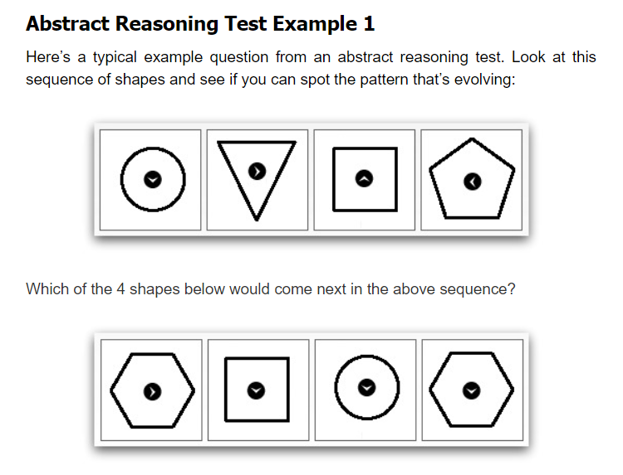

Slide 16
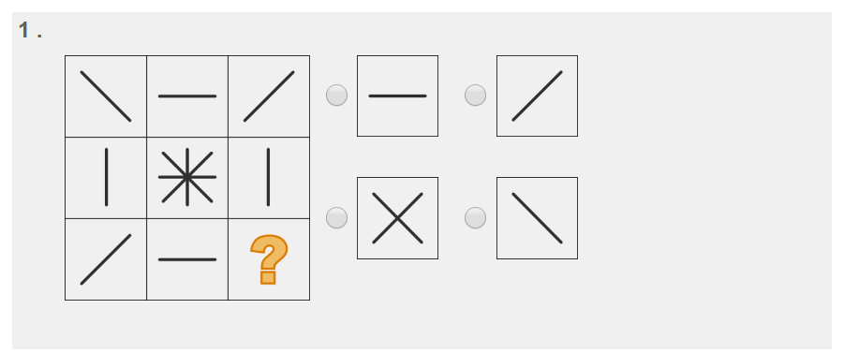

Slide 17
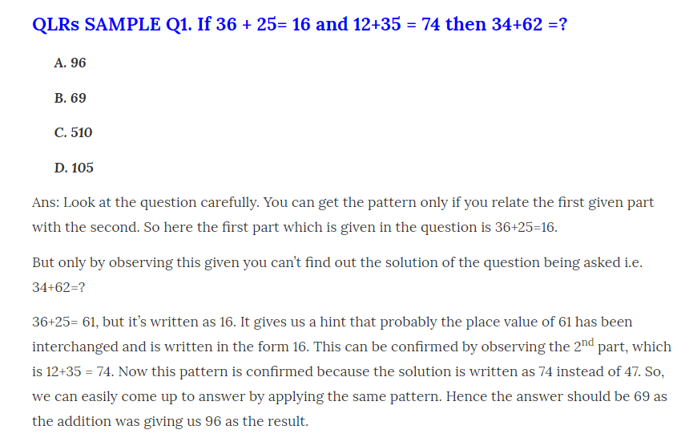

Slide 18
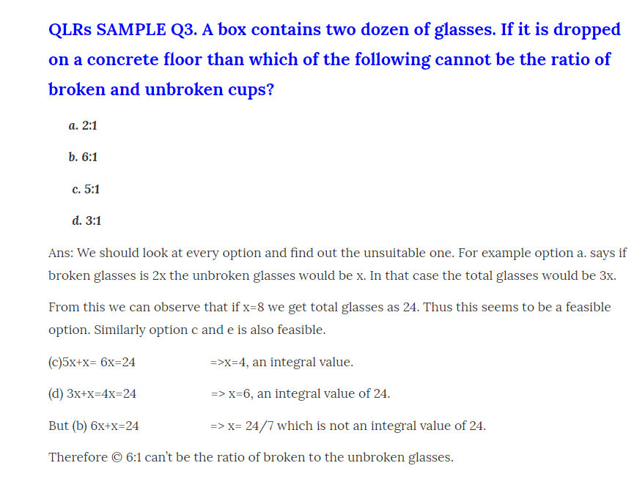

Slide 19
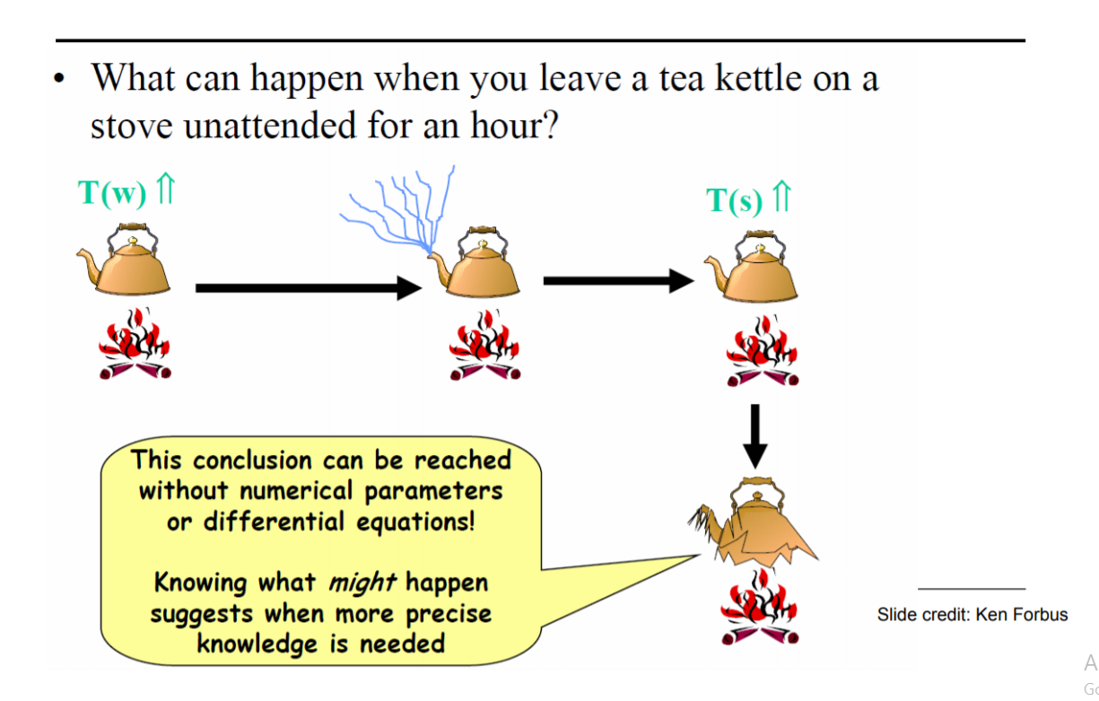

Slide 20
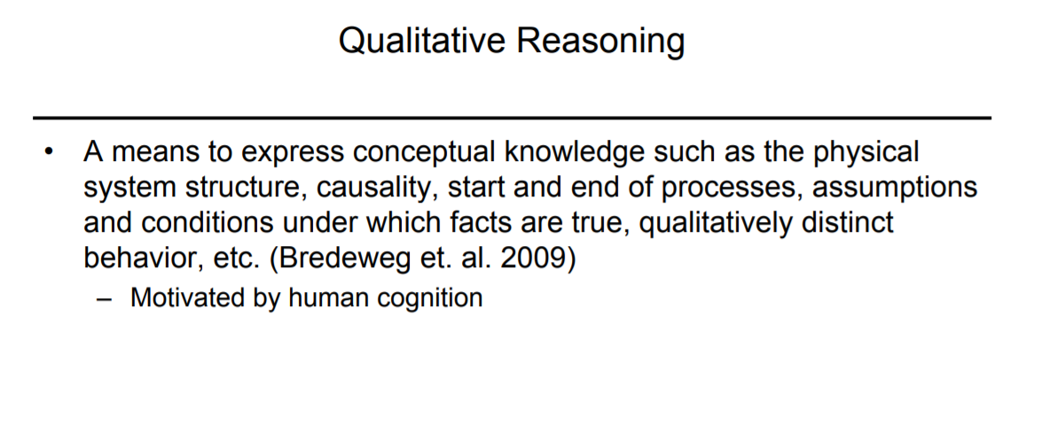

Slide 21
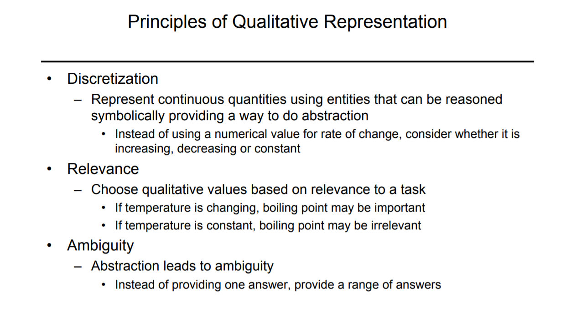

Slide 22
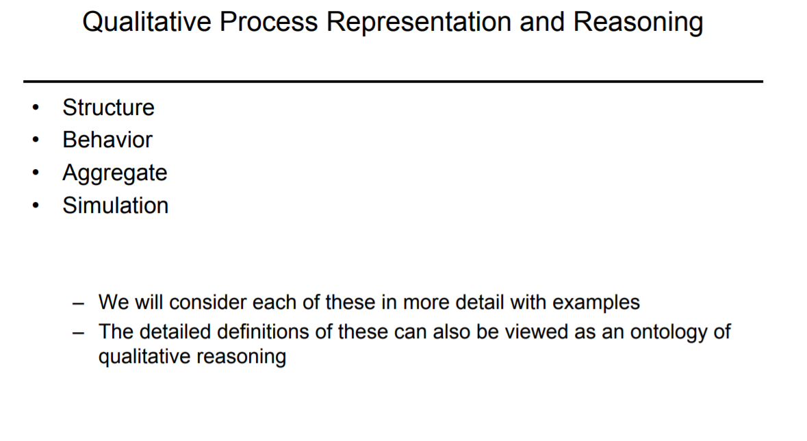

Slide 23
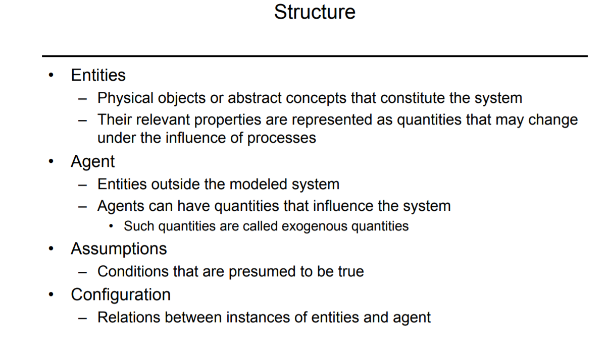

Slide 24
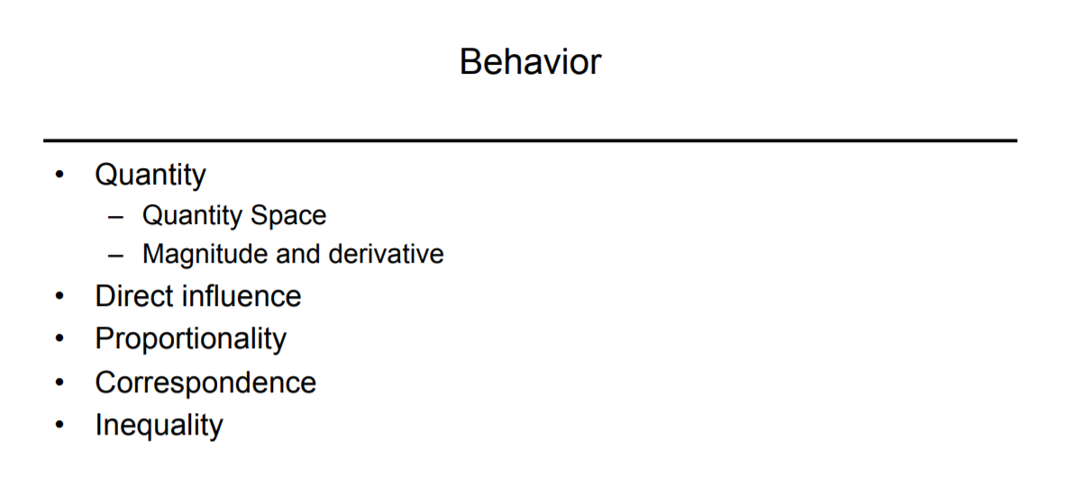

Slide 25
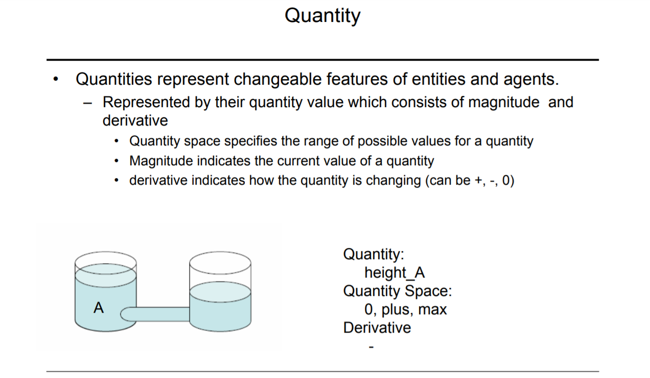

Slide 26
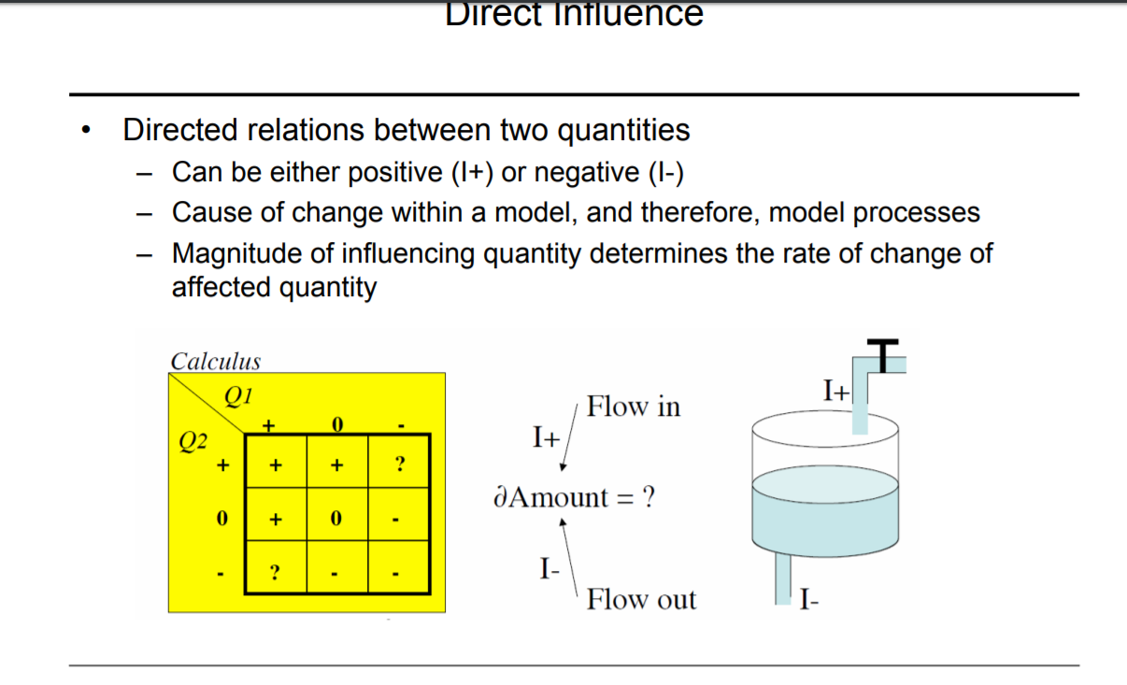

Slide 27
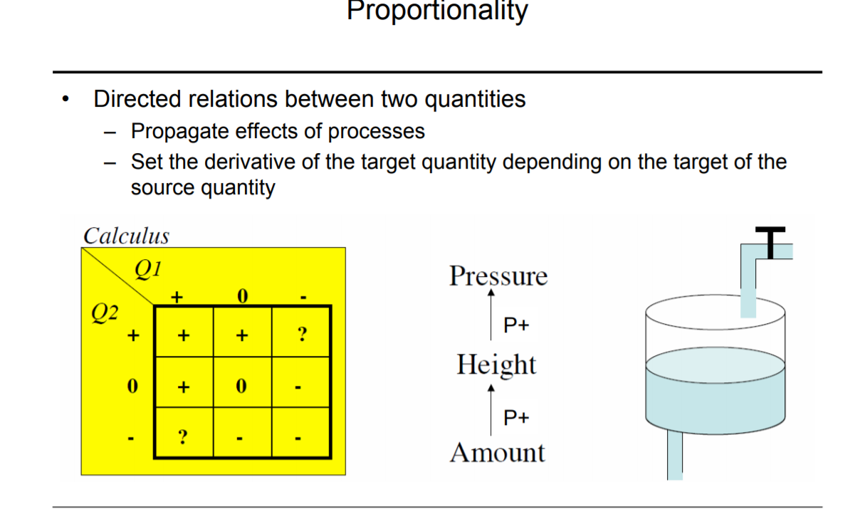

Slide 28
Python SDKs for various Cognitive Services services.
Add image and face recognition, language analysis, and search to your Python apps, websites, and tools using the Azure Cognitive Services modules for Python.

Slide 29
https://docs.microsoft.com/en-us/python/api/overview/azure/cognitive-services?view=azure-python

Slide 30
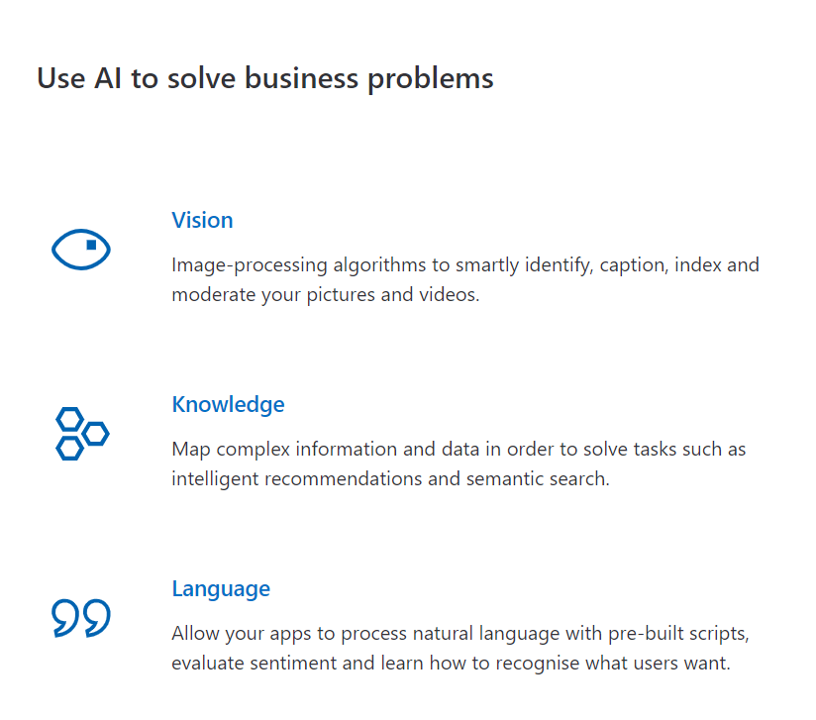

Slide 31
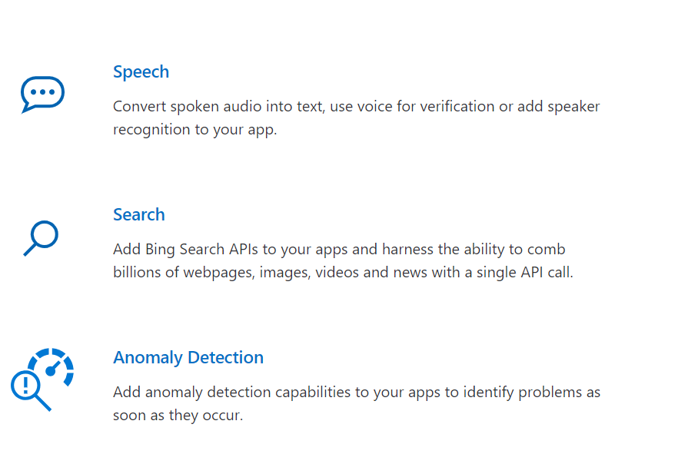

Slide 32
Language Understanding (LUIS)
Computer Vision
Speaker Recognition

Slide 33
So what is a chatbot?
A chatbot is an artificial intelligence-powered piece of software in a device (Siri, Alexa, Google Assistant etc), application, website or other networks that try to gauge consumer’s needs and then assist them to perform a particular task like a commercial transaction, hotel booking, form submission etc .Today almost every company has a chatbot deployed to engage with the users. Some of the ways in which companies are using chatbots are:
To deliver flight information
to connect customers and their finances
As customer support

Slide 34
History of chatbots dates back to 1966 when a computer program called ELIZA was invented by Weizenbaum. It imitated the language of a psychotherapist from only 200 lines of code. You can still converse with it here: Eliza.

Slide 35
